Slide 1
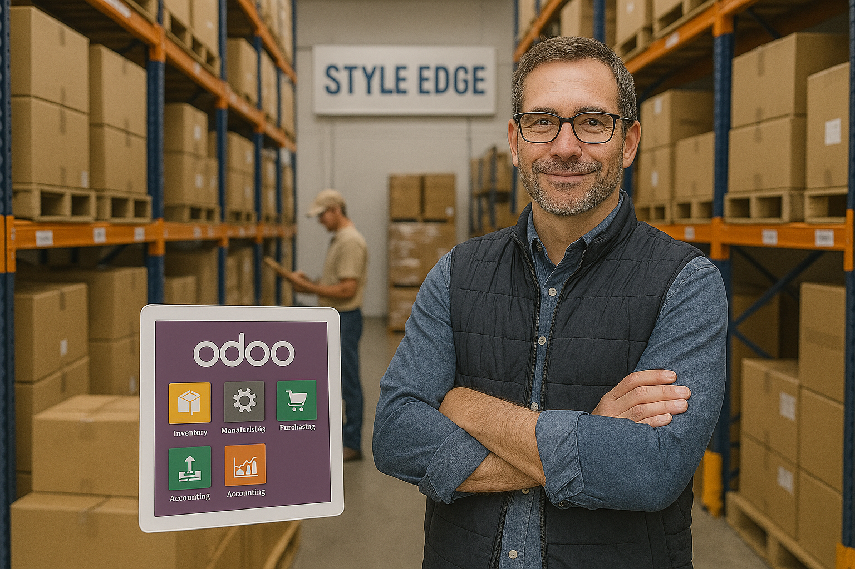

STYLE EGDE
Digital Dreams, Real Results
Connecting all parts of Style Edge through one smart, powerful system: Odoo.

Slide 2
2
PART 1
About Style Ege
Table of Contents
PART 2
Business Requirements
PART 3
Designing The Solution
PART 4
Solution Implementation

Slide 3

3
STYLE EDGE
A brief About Style Edge
Style Edge is a clothing factory that designs, produces, and sells high-quality fashion products. It focuses on creativity, quality, and meeting customer needs.

Slide 4
4
STYLE EDGE
Style Edge currently faces significant challenges, including data inconsistencies across sales, inventory, and accounting systems. Manual processes in purchasing and manufacturing lead to inefficiencies and errors, while the absence of real-time information makes decision-making difficult. Communication gaps between departments cause delays in order fulfillment, and the lack of automation is limiting the company’s ability to scale and compete effectively. Our ERP solution will address these issues by integrating all functions into one system, streamlining operations, and providing real-time insights to drive growth and efficiency.
How do we get there?

Slide 5
5
Business Requirements
1
2
3
4
5
Real-Time Inventory Tracking
Customizable Pricing and Discounting
Production Scheduling and Workflow Management
Integrated Workflow Management
Real-Time Reporting and Analytics
The system must update stock levels in real time, preventing stockouts and overstocking.
The system should allow flexible pricing and discount rules across all modules.
The system should ensure seamless integration between purchase, sales, inventory, and manufacturing modules for smooth operations and data consistency.
The system should provide real-time data and reports across all modules, enabling quick decision-making and performance monitoring.
The system must allow efficient production scheduling, managing work orders and resources while tracking production progress in real time

Slide 6
Choosing
Odoo
Purchase
Sales
Style Edge chose Odoo for its integrated, all-in-one ERP solution that streamlines sales, inventory, purchasing, manufacturing, and accounting. Odoo’s real-time data, customization options, and scalability make it the perfect fit for improving efficiency and supporting growth.
Inventory
manufacturing
Accounting
Human Resources
6

Slide 7
Purchase
Raw Material
Inventory
Manufactoring
Inventory
Finished products
Point of Sale
B2C
Sales
B2B
Accounting: Invoicing, Stock Valuation, Billing,
HR Management : Recruiting, Payroll
STYLE EDGE
FLOWCHART
7

Slide 8
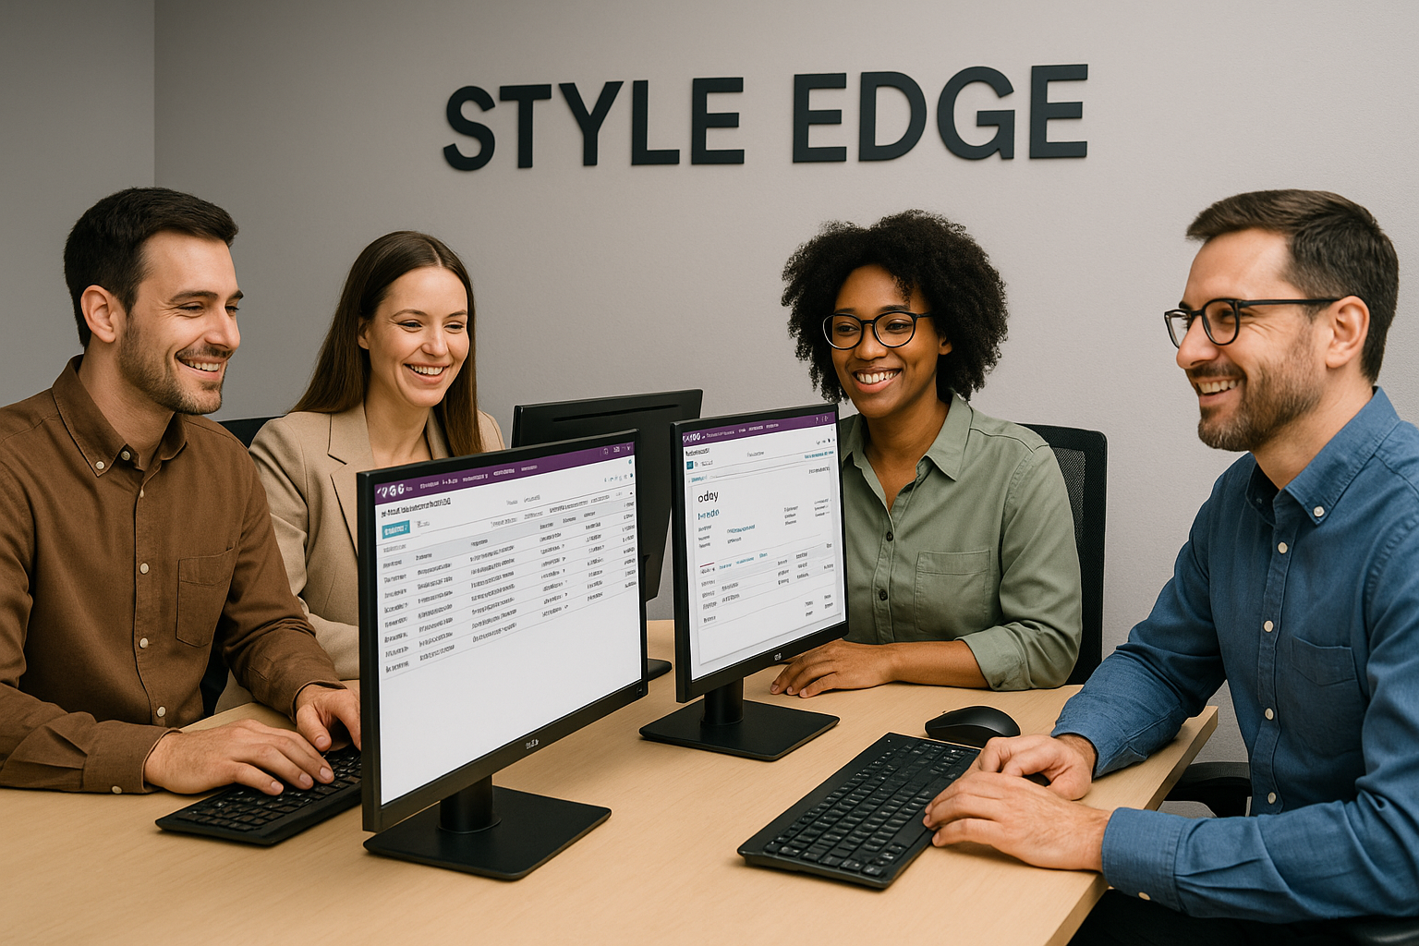
8
Purchase Module
The Purchase module manages supplier relationships, purchase orders, and product receipts to streamline the procurement process.

Slide 9
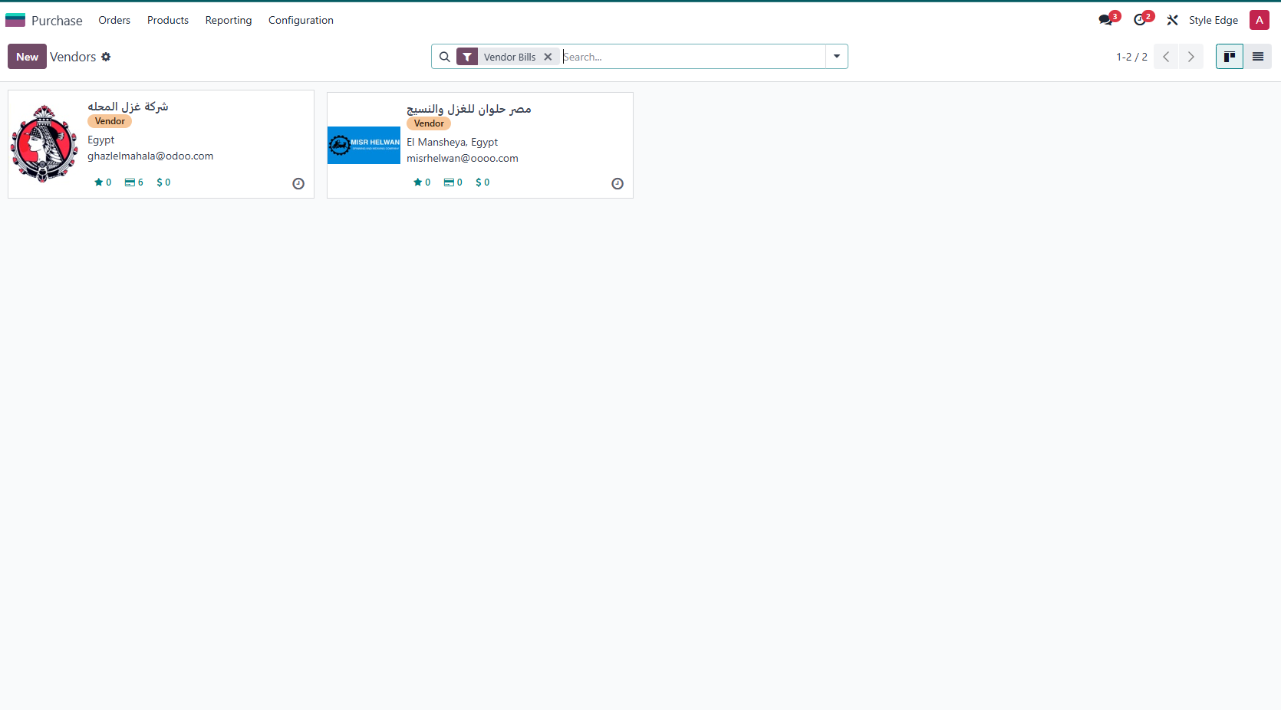
Vendor’s list
9

Slide 10
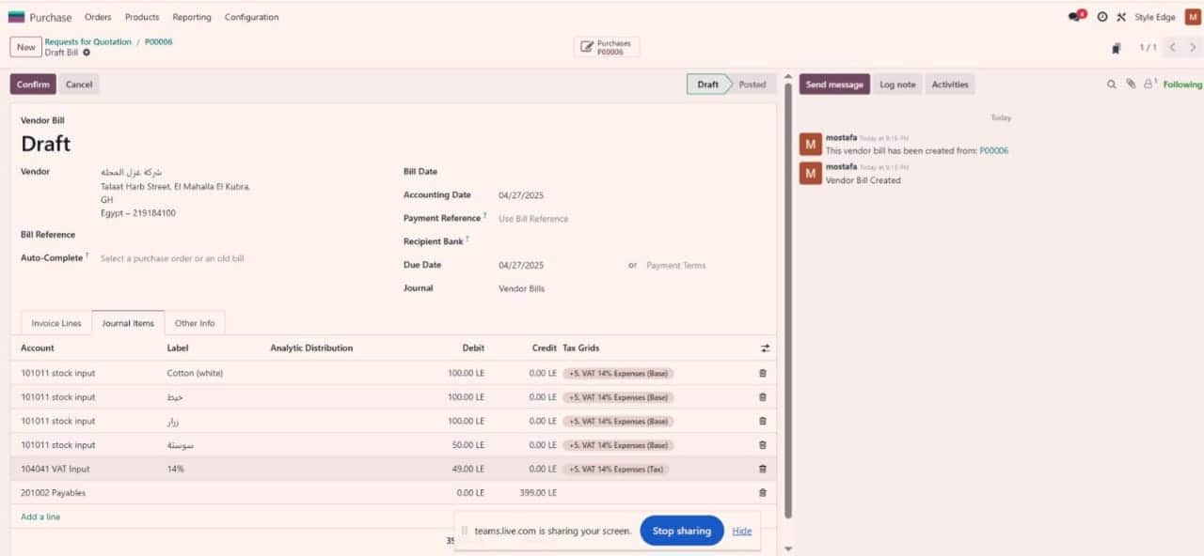
Request For Quotation
10

Slide 11
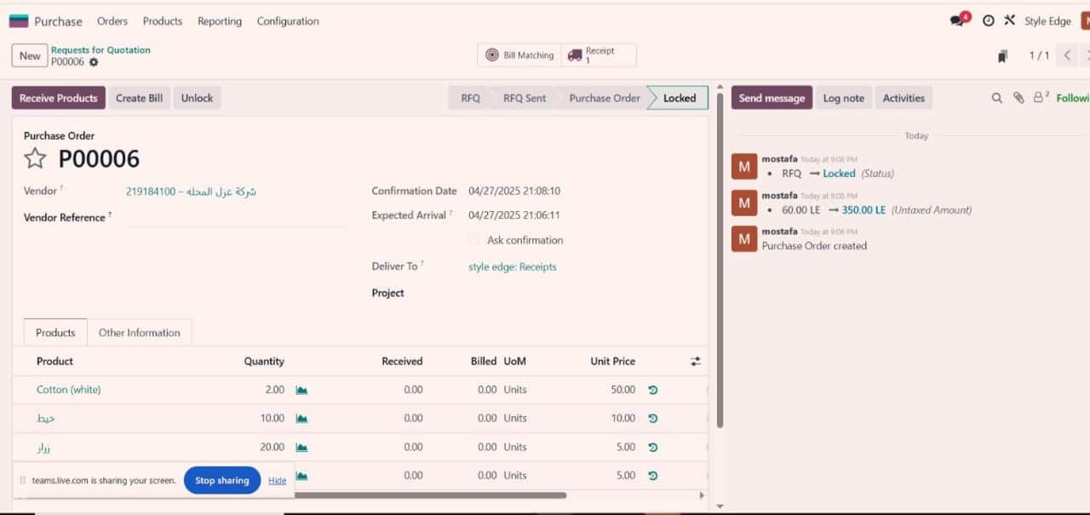
Confirm Quotation (PO)
11

Slide 12
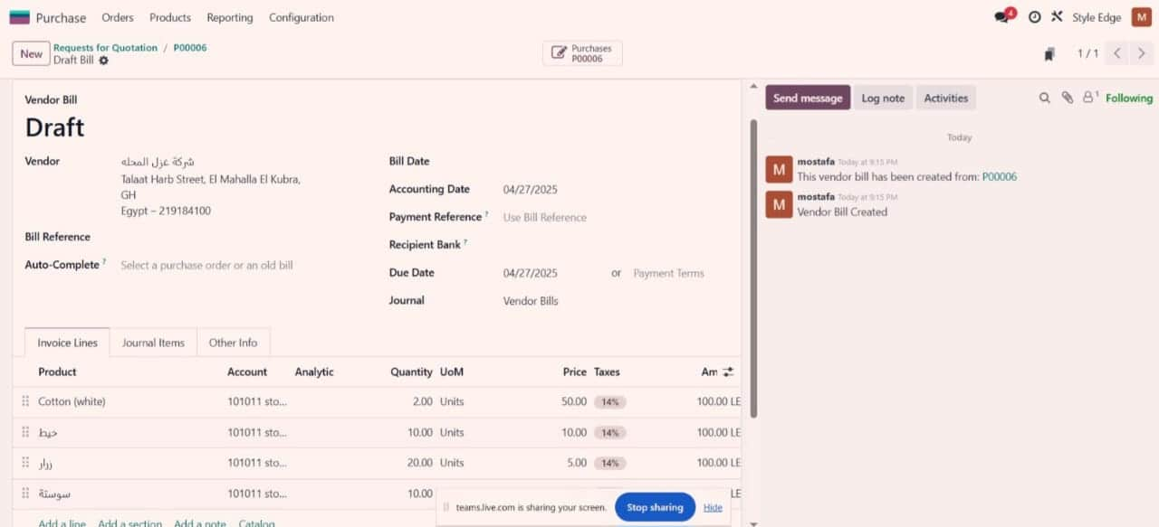
Billing Vendors
12

Slide 13

13
Manufactring
The Manufacturing module plans, manages, and tracks production orders to ensure efficient manufacturing and product delivery.

Slide 14
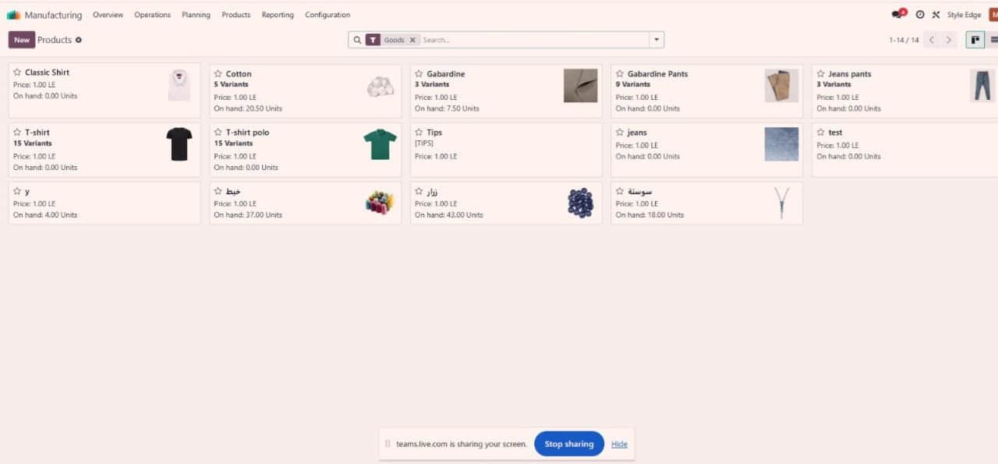
Products
14

Slide 15
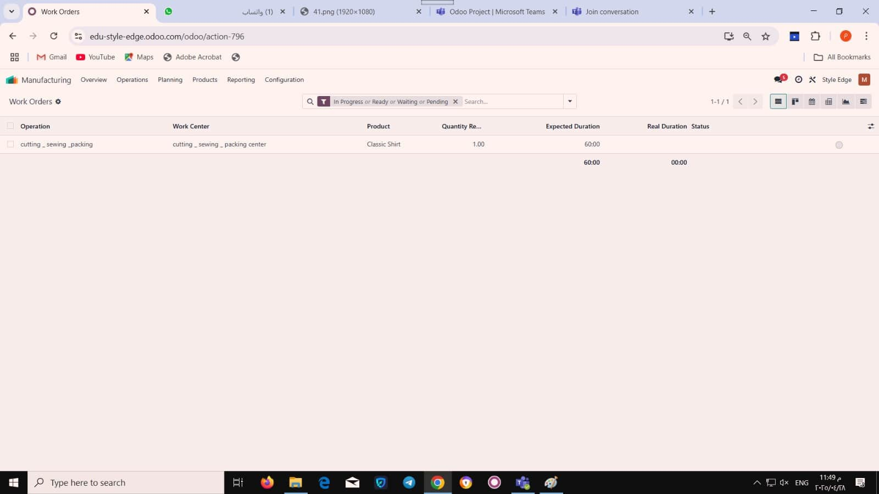
Operations
15

Slide 16
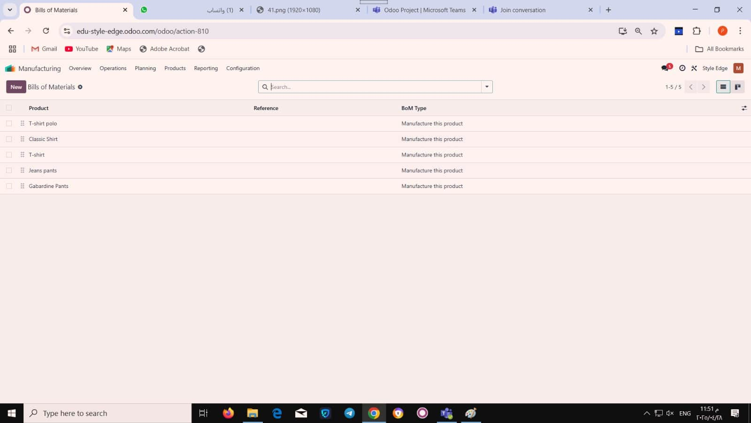
Bill of Materials
16

Slide 17
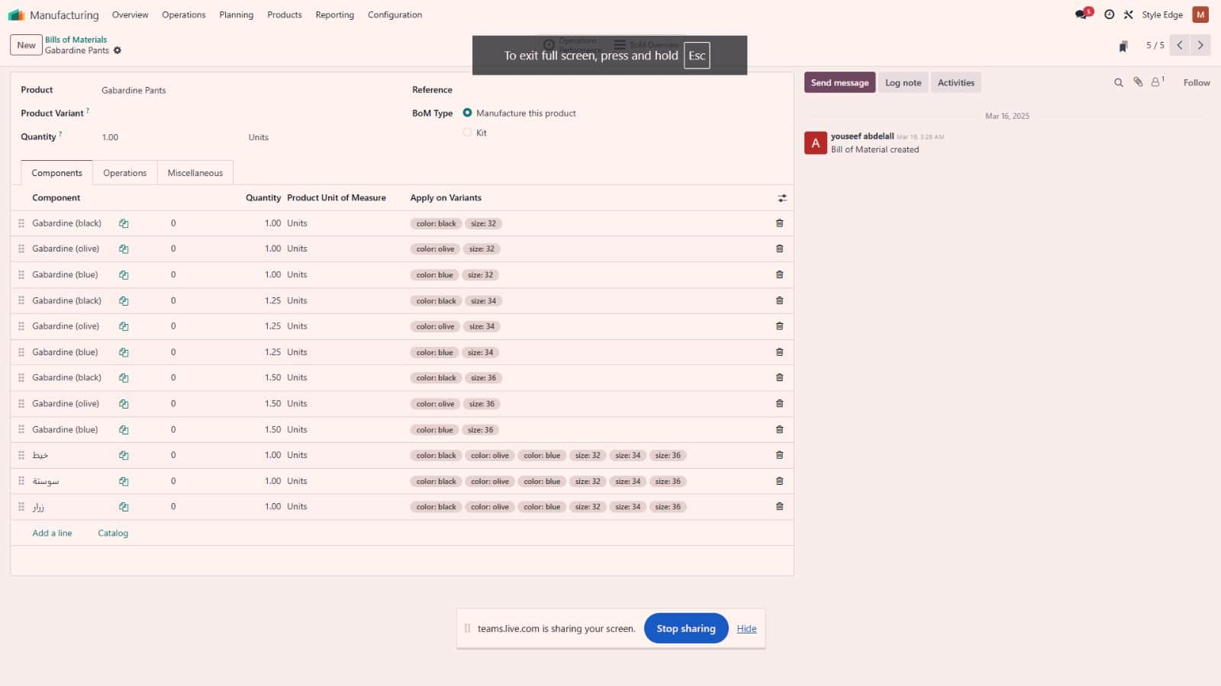
Product Bill Of Materials
17

Slide 18
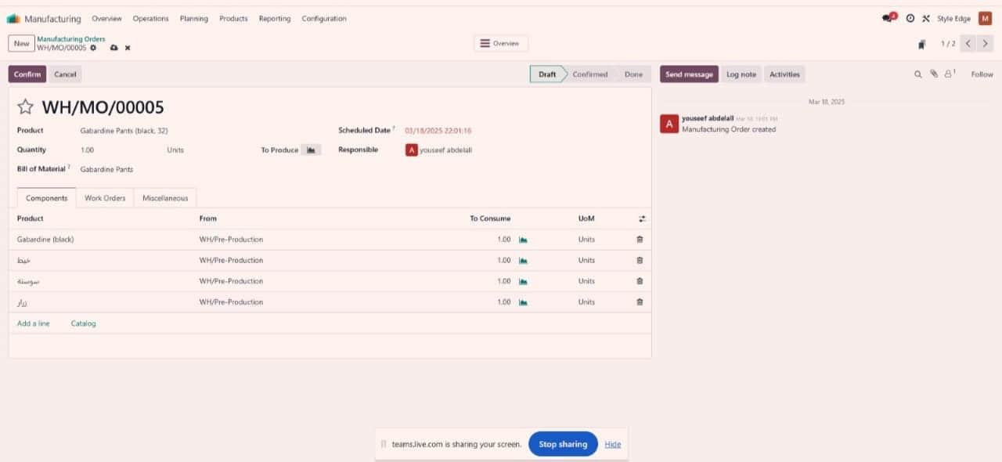
Manufactre Order
18

Slide 19
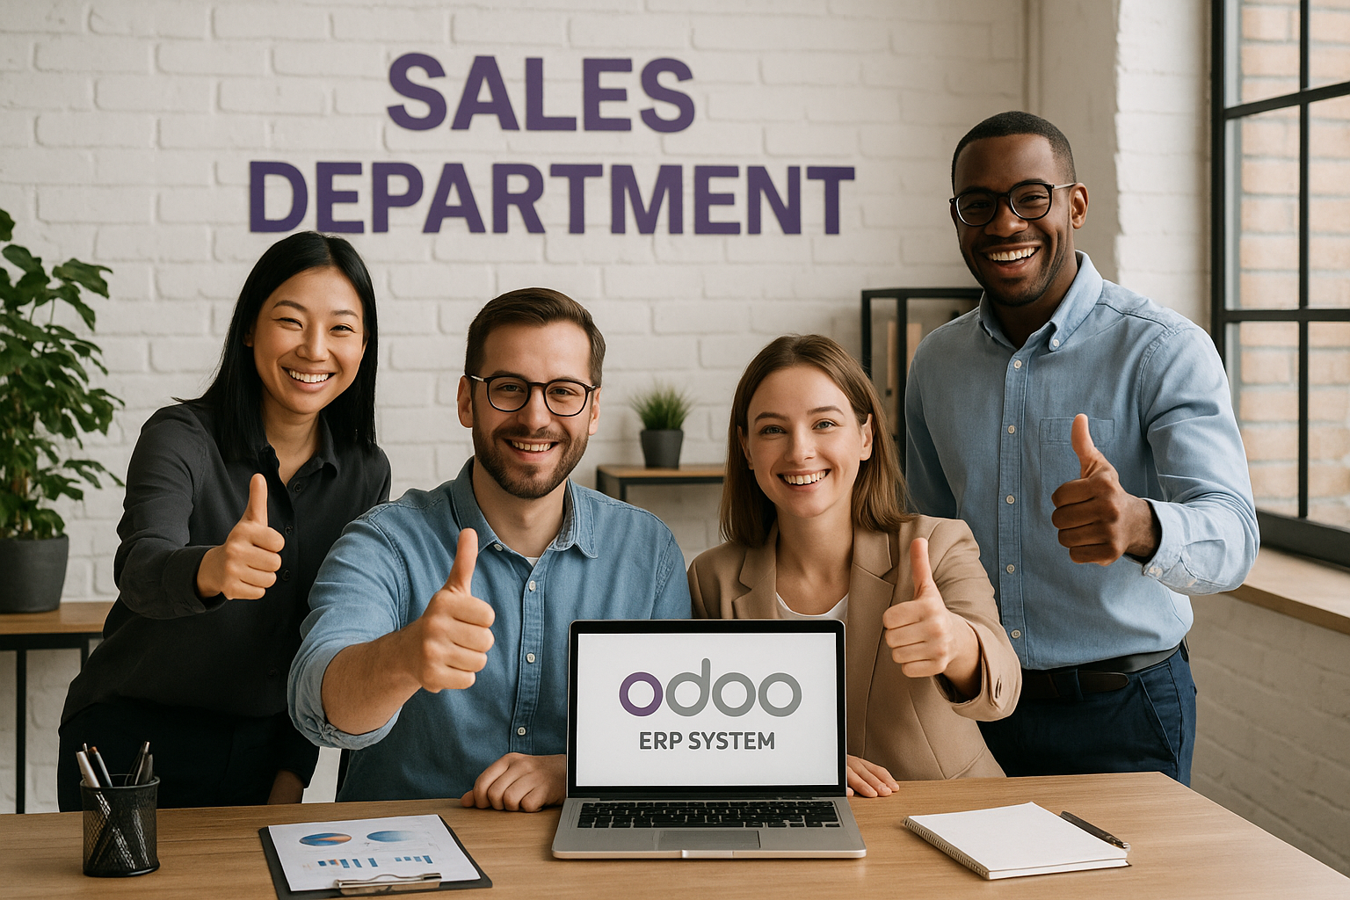
19
Sales Module
The Sales module manages the entire sales process, from creating quotations to confirming orders and invoicing customers.

Slide 20
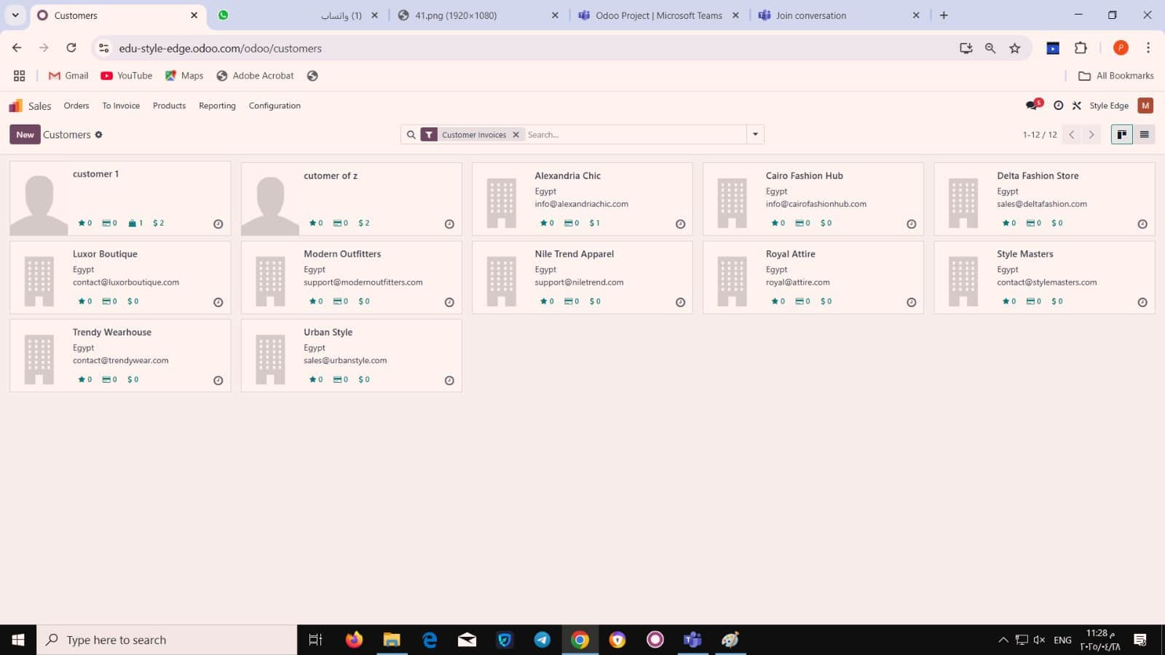
Customers
20

Slide 21
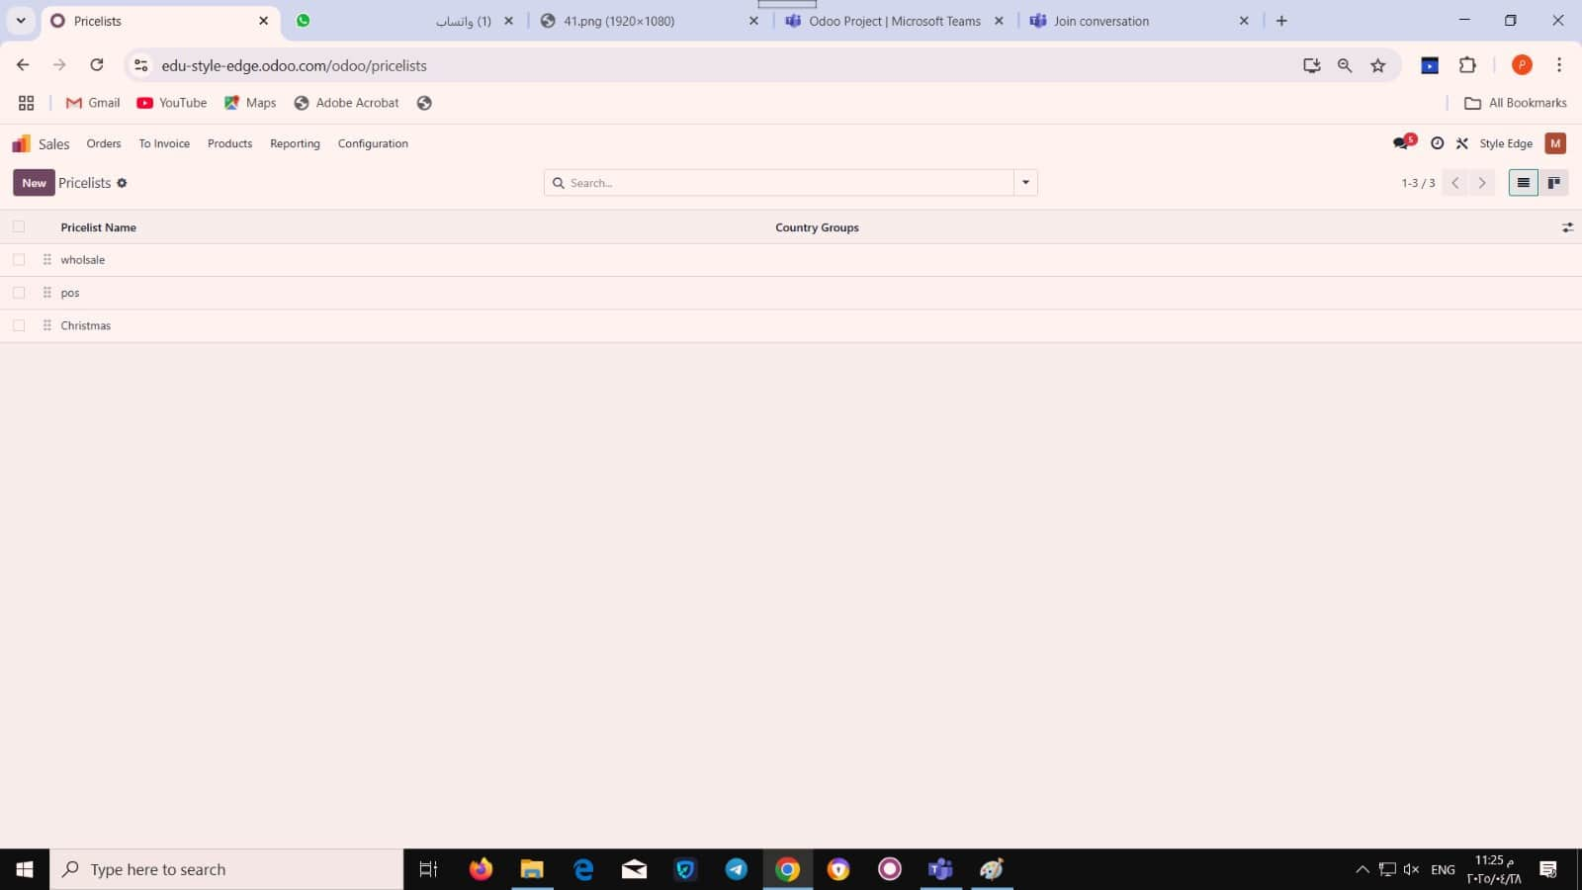
Pricelists
21

Slide 22
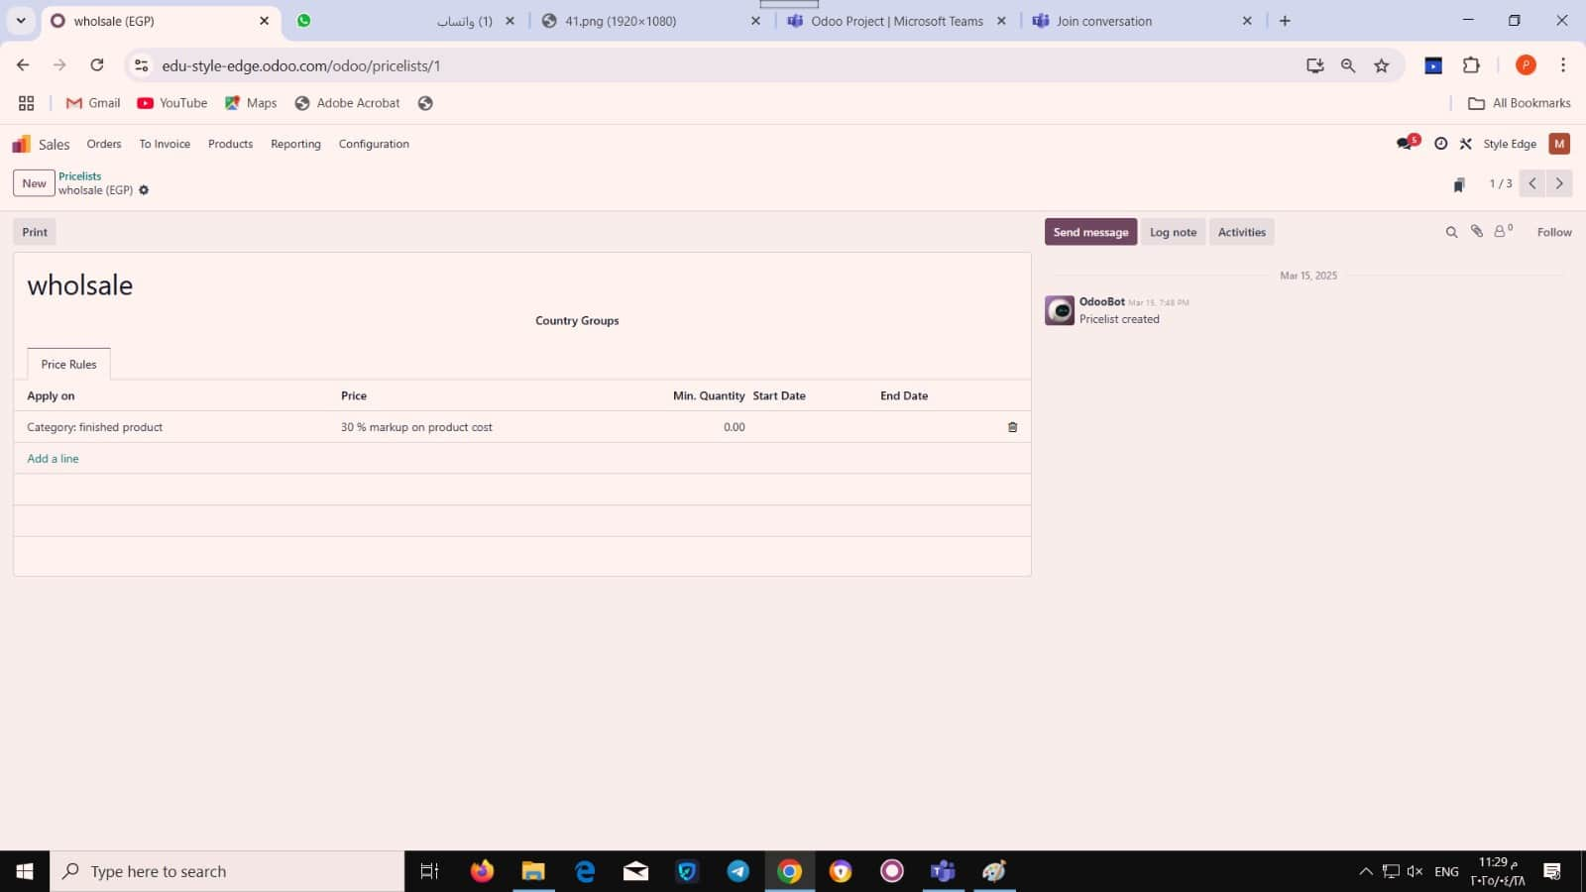
Whole Sale Pricelist
22

Slide 23
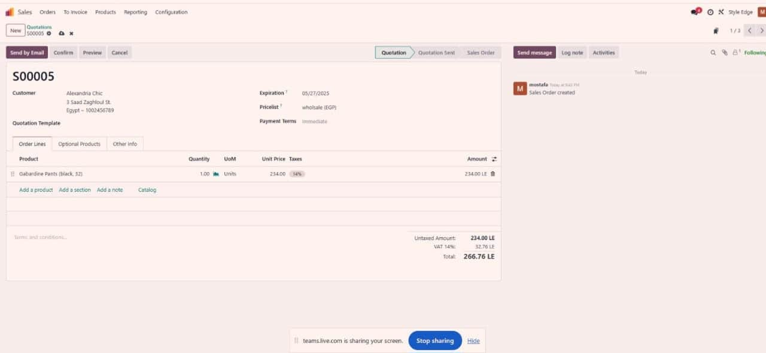
Quotation
23

Slide 24
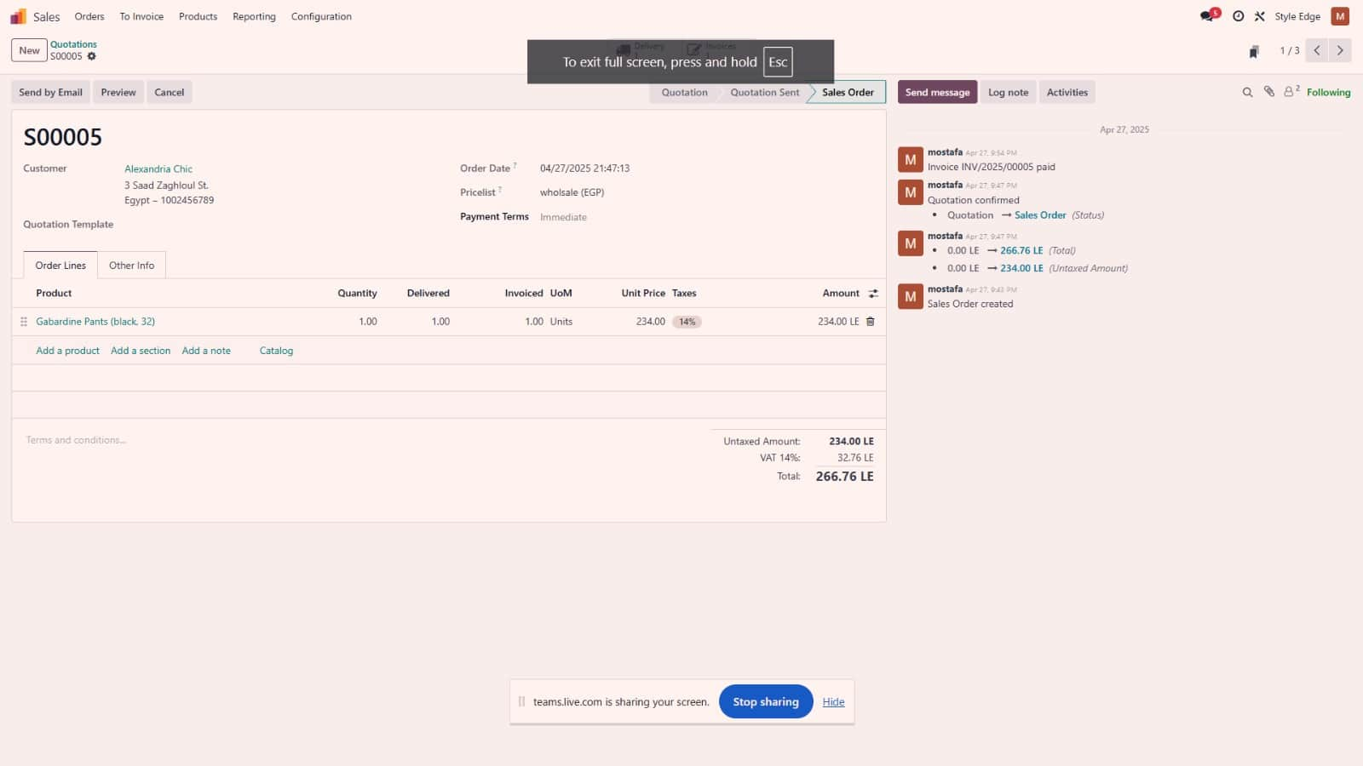
Invoicing Customers
24

Slide 25
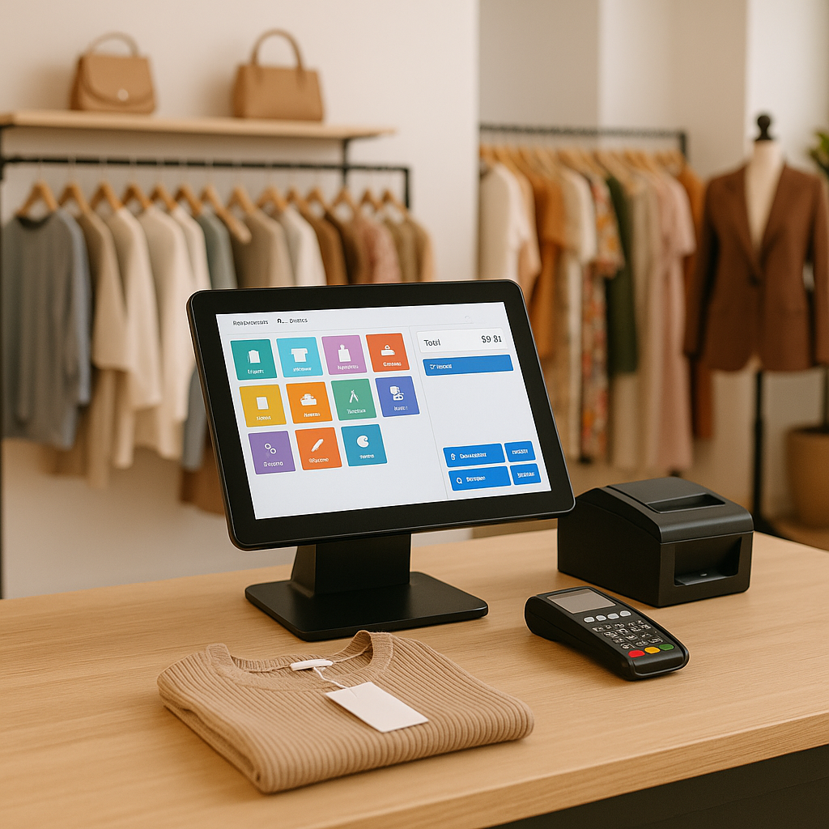
25
POS
The POS module manages retail sales operations in real time, connecting sales, inventory, and customer payments through an easy-to-use interface.

Slide 26
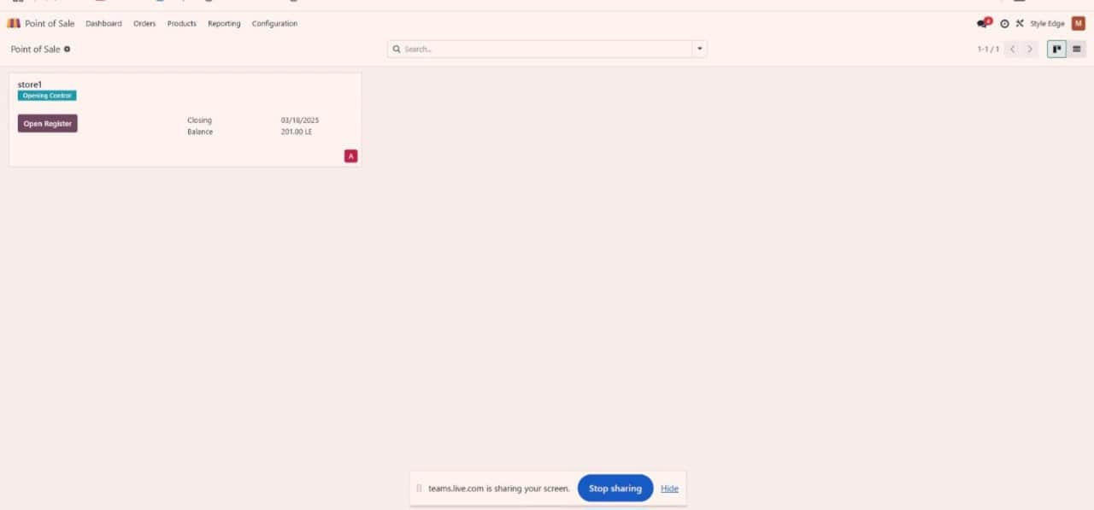
Point of sales
26

Slide 27
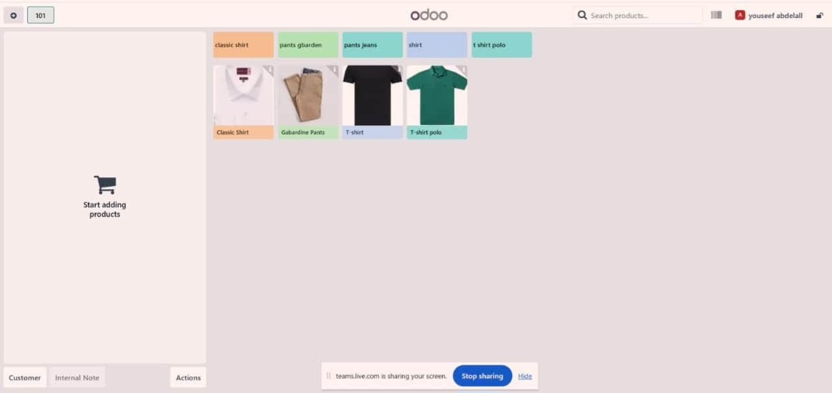
Opening a Session
27

Slide 28
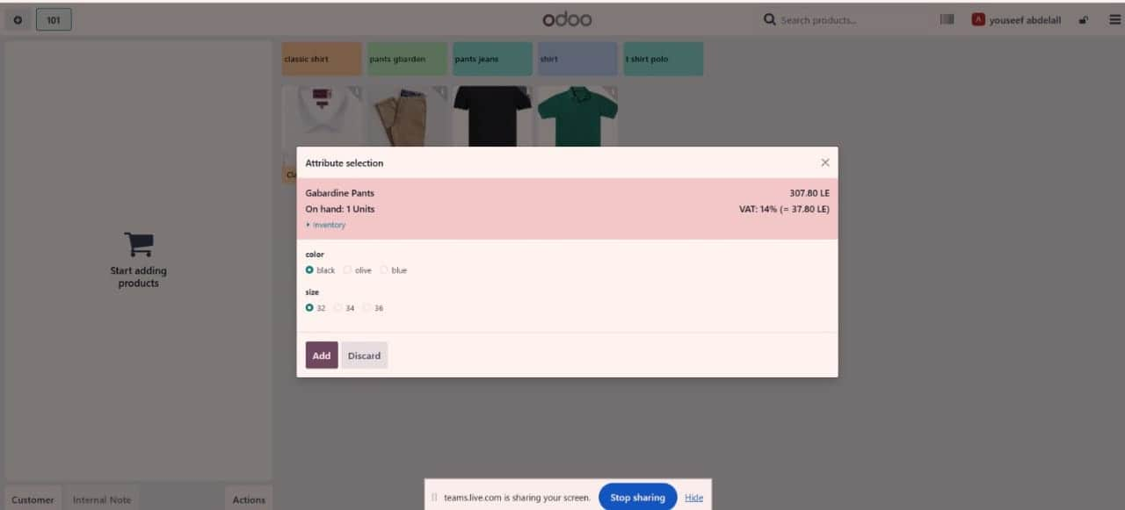
Selling Products
28

Slide 29

29
Inventory
Module
The Inventory module controls stock movements, manages warehouses, and ensures accurate product tracking across the supply chain.

Slide 30
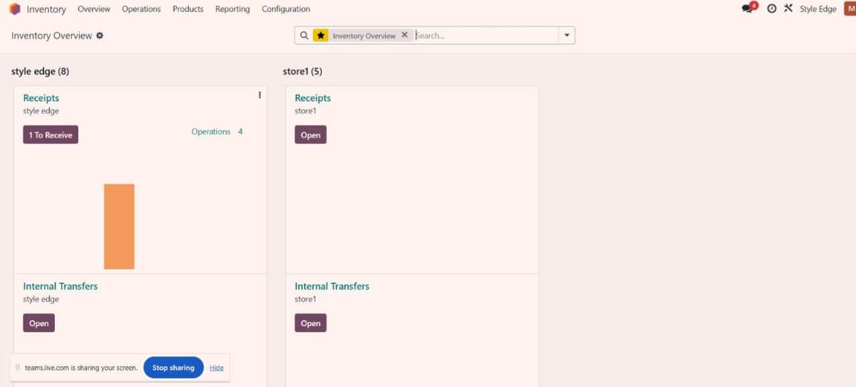
Warehouses
29

Slide 31
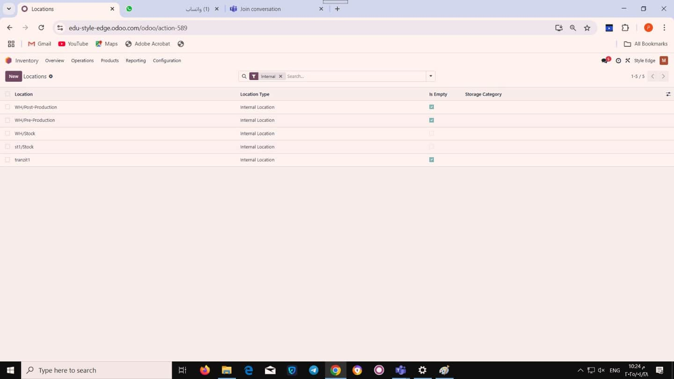
Inventorey Locations
31

Slide 32
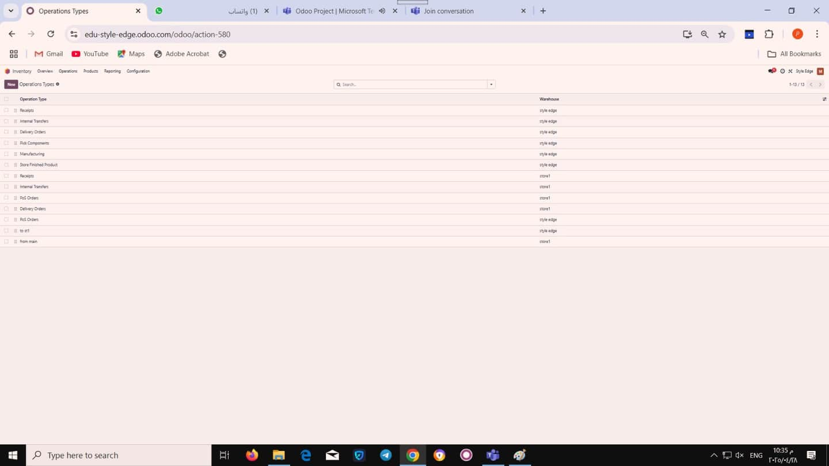
Operation types
32

Slide 33
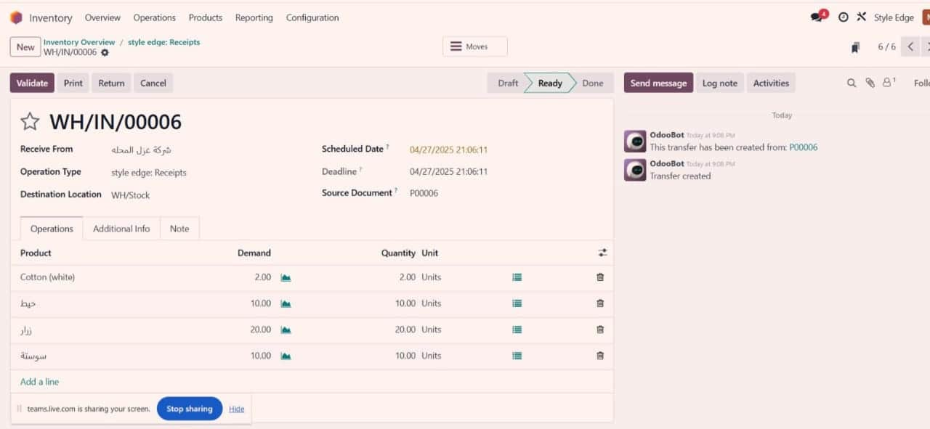
Recieve at WHSTOCK
33

Slide 34
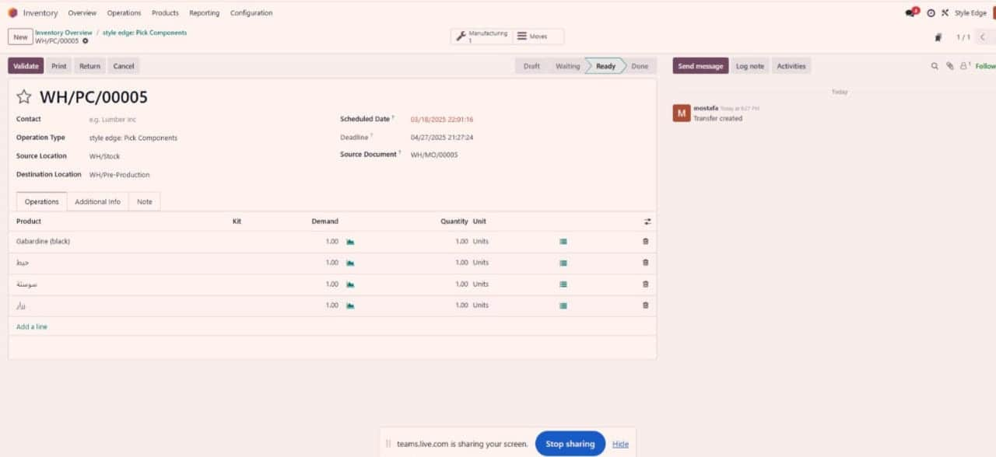
Moving Material To Pre Production Location
34

Slide 35
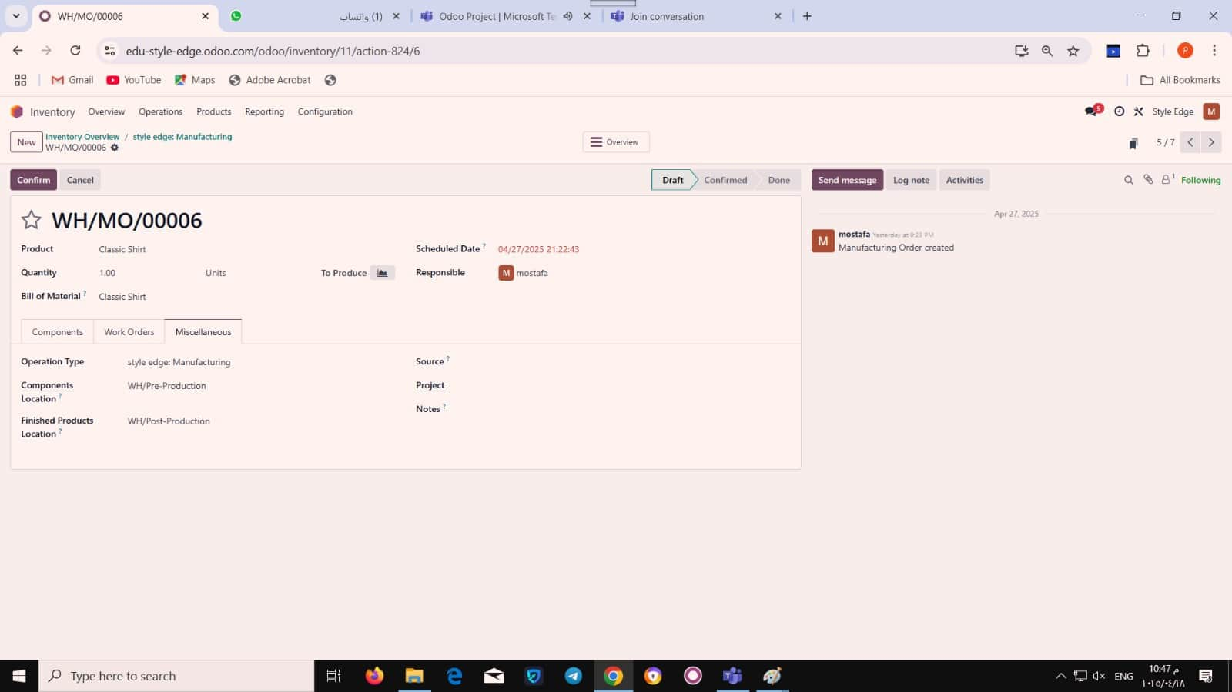
Moving “WIP” To Post Production
35

Slide 36
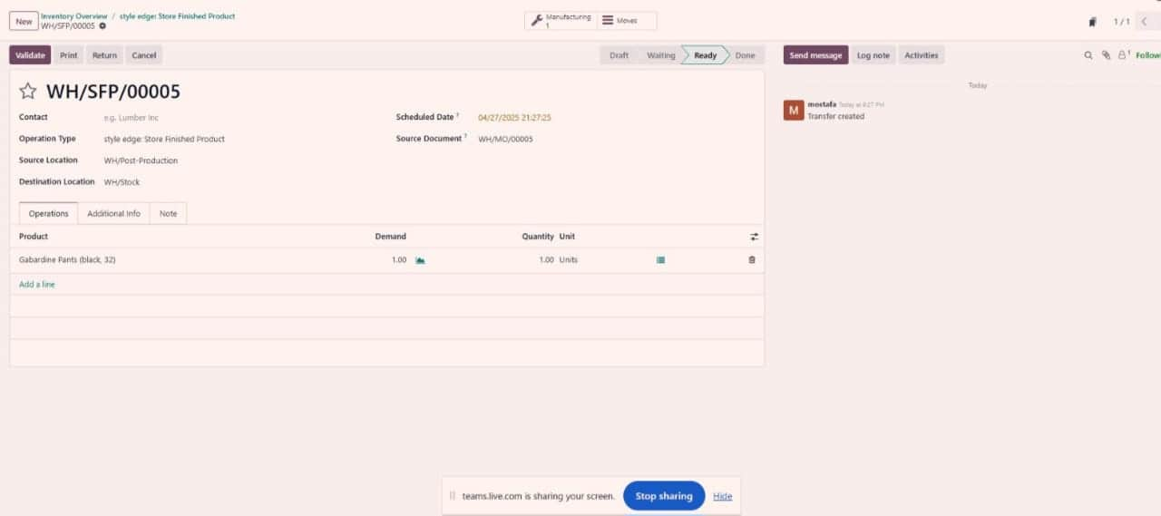
Moving “FB” To WH/Stock
36

Slide 37
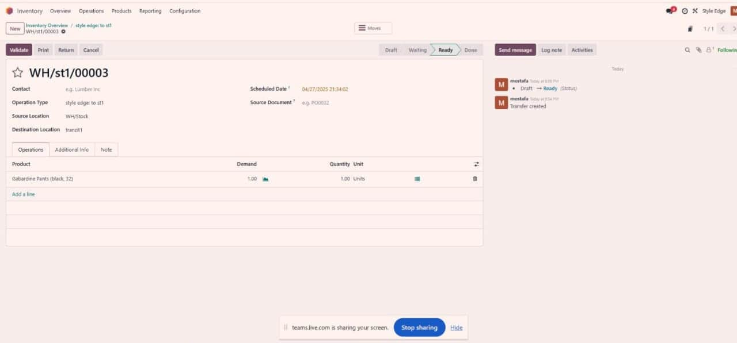
Moving To Delivery Car
37

Slide 38
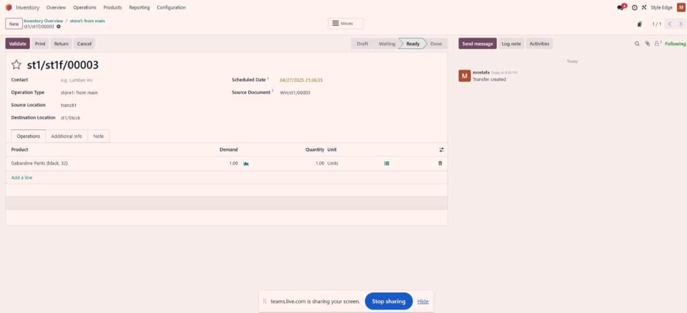
Moving To Point of sale Store
38

Slide 39
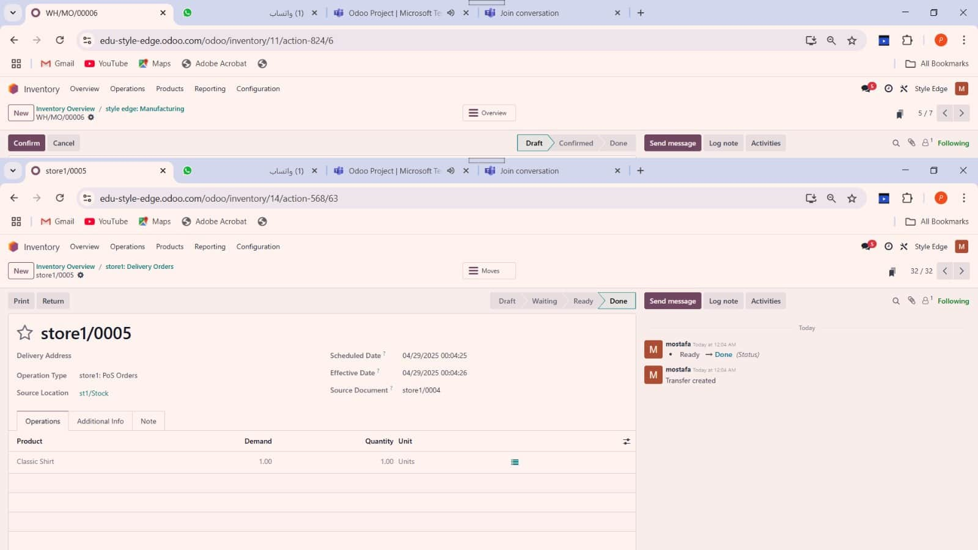
POS Product Delivery
39

Slide 40

40
Human Resources (HR)
Odoo's HR module manages recruitment, payroll, attendance, and performance, automating HR processes for efficient workforce management.

Slide 41
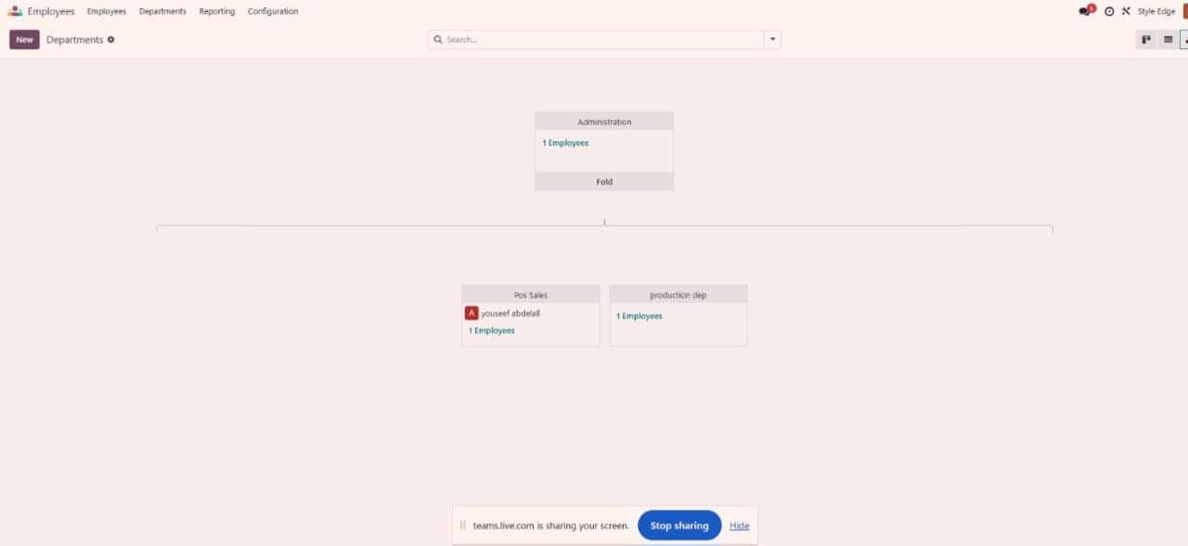
Organization Hierarchy
41

Slide 42
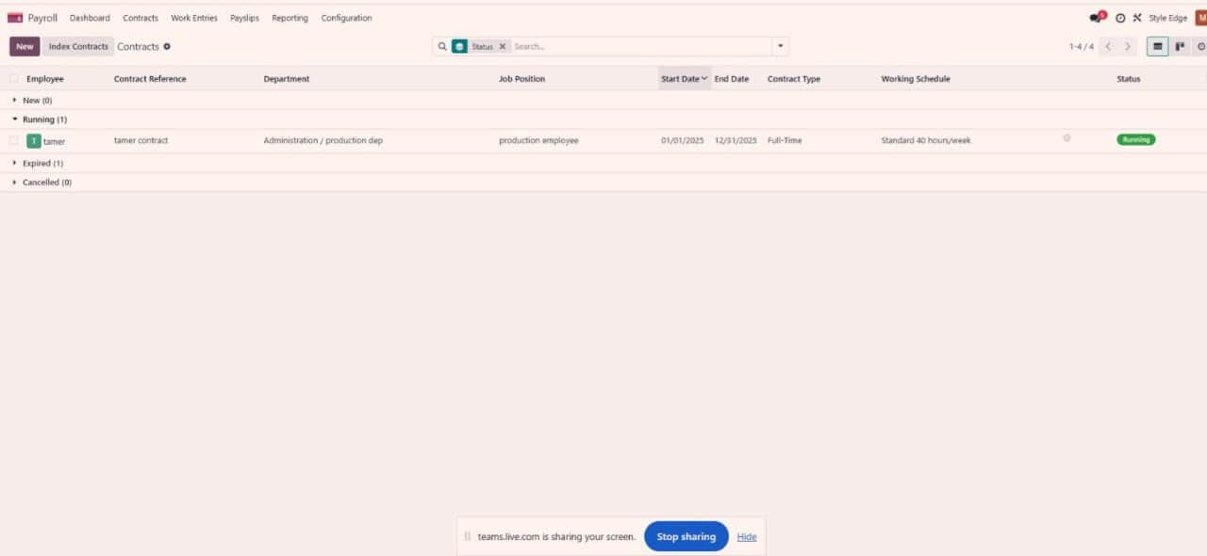
Contracts
42

Slide 43
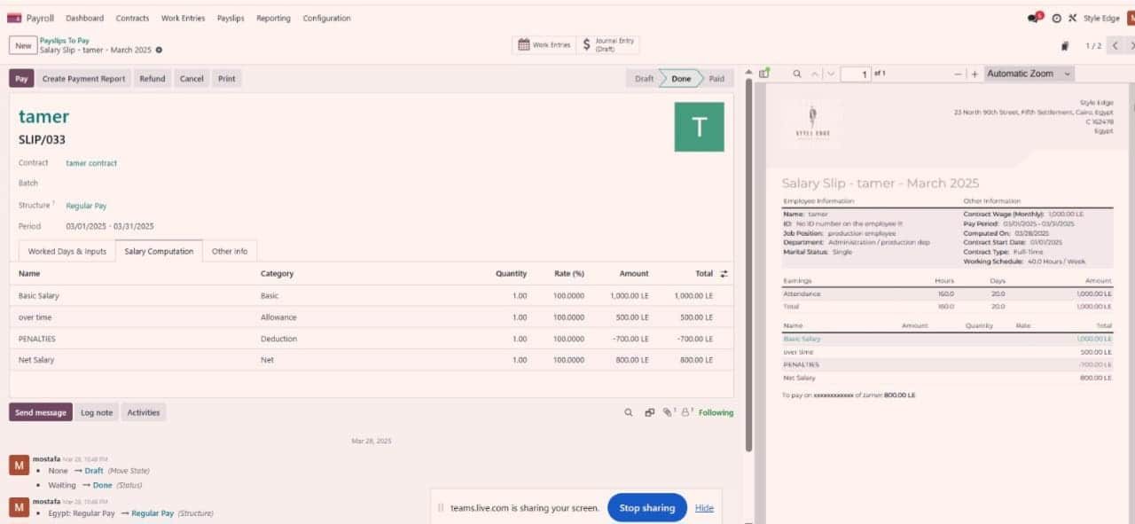
Payslips
46

Slide 44
44
Accounting
Odoo's Accounting module manages invoicing, payments, taxes, and reporting, integrating with other modules for seamless financial management.

Slide 45
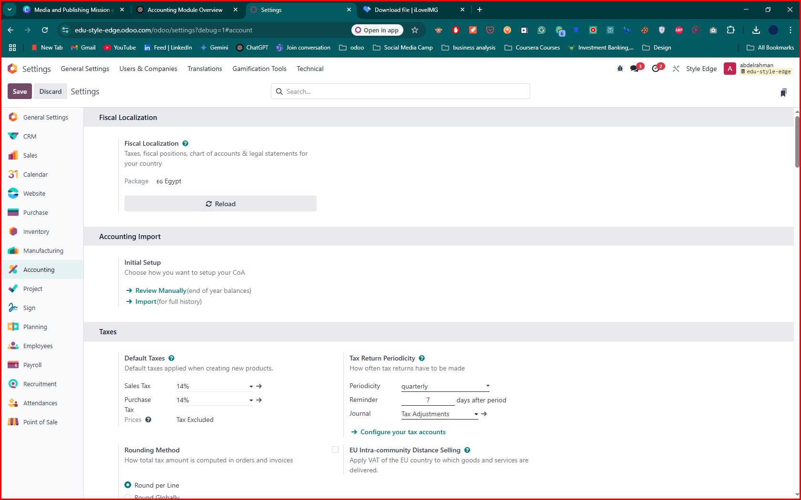
Localization
45

Slide 46
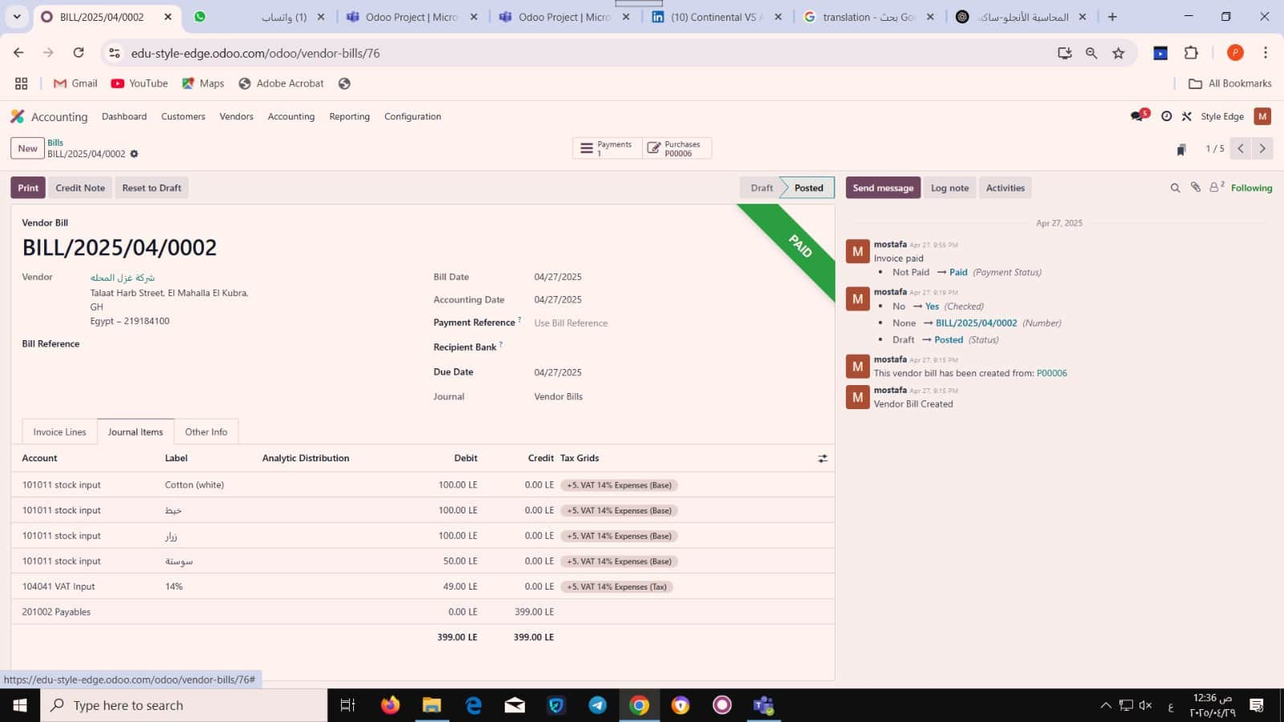
Vendor billing Entry
46

Slide 47
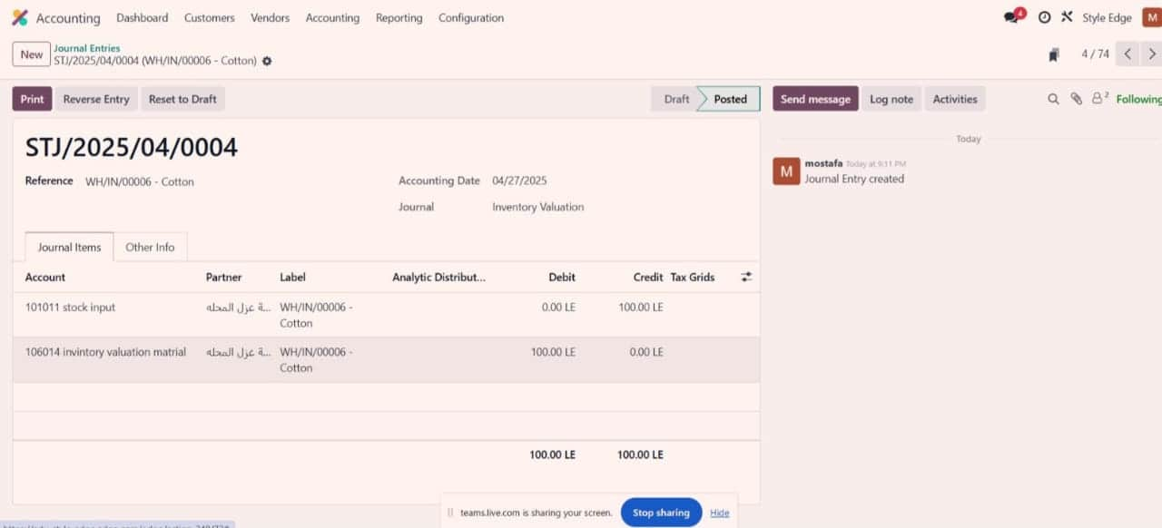
Inventorey Valuation Entry
47

Slide 48
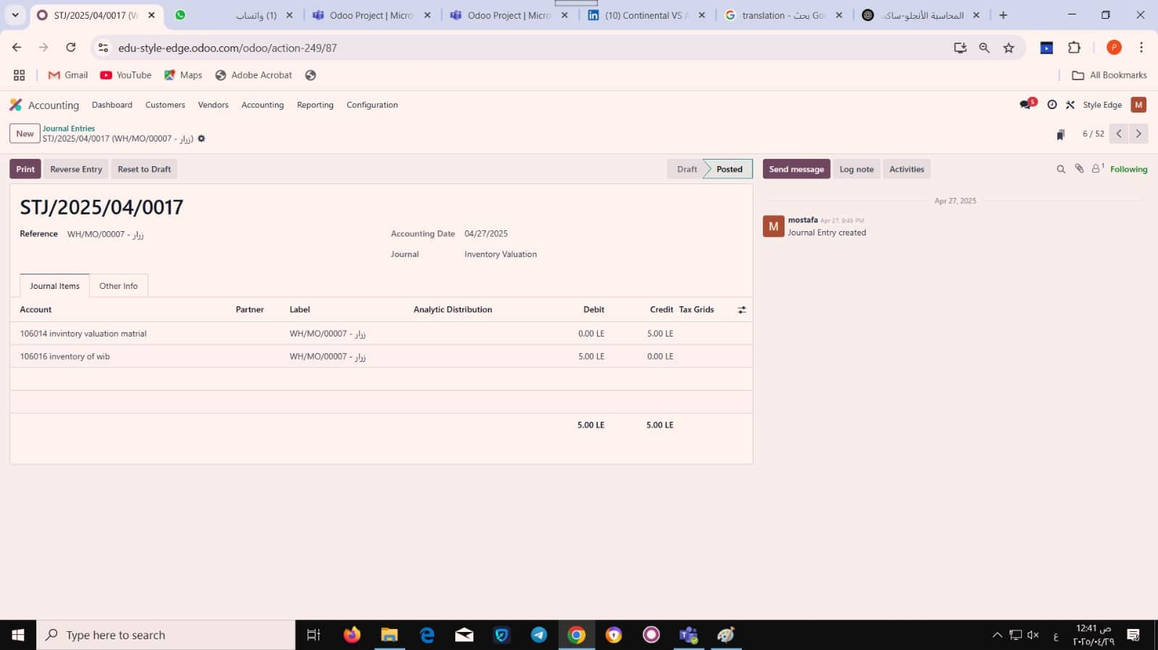
Manufactring Process Entry
48

Slide 49
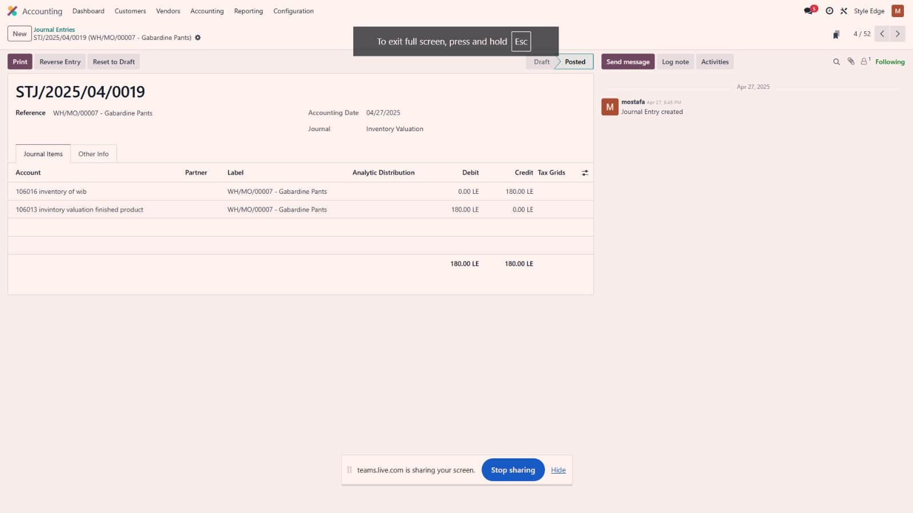
Finished Product Valuation Entry
49

Slide 50
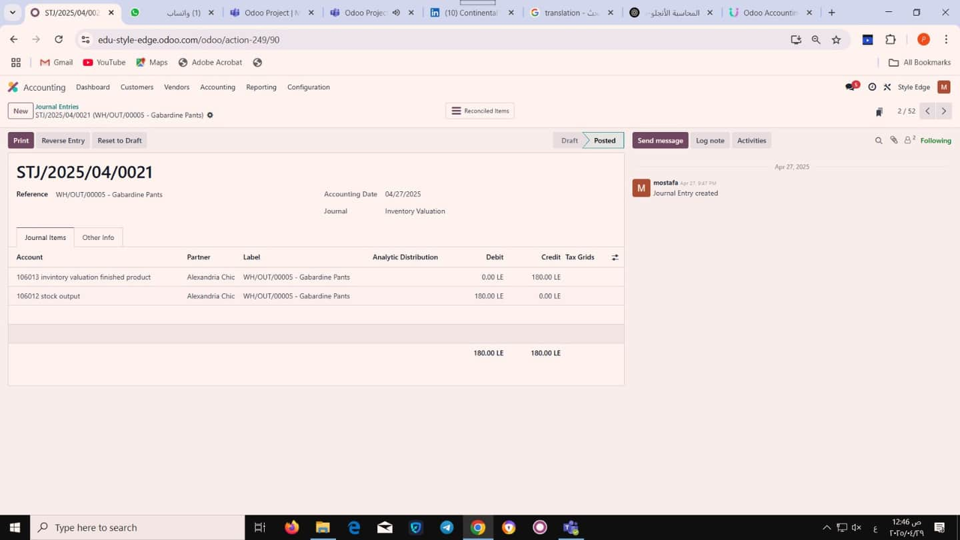
Finshed Product Entry
50

Slide 51
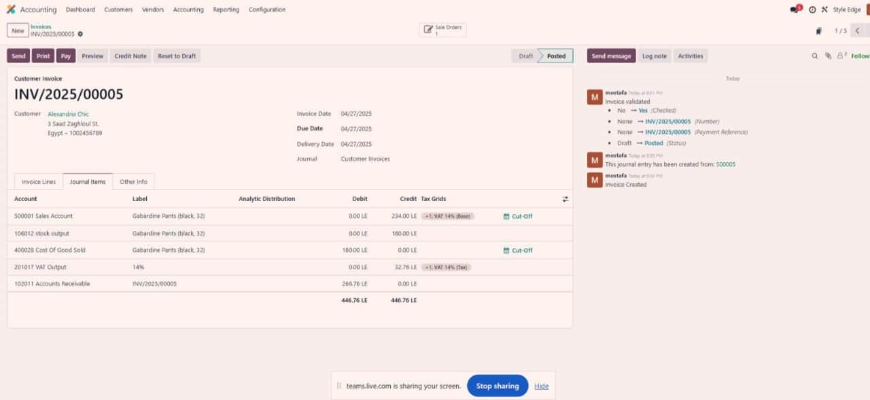
Invoicing Entry
51

Slide 52
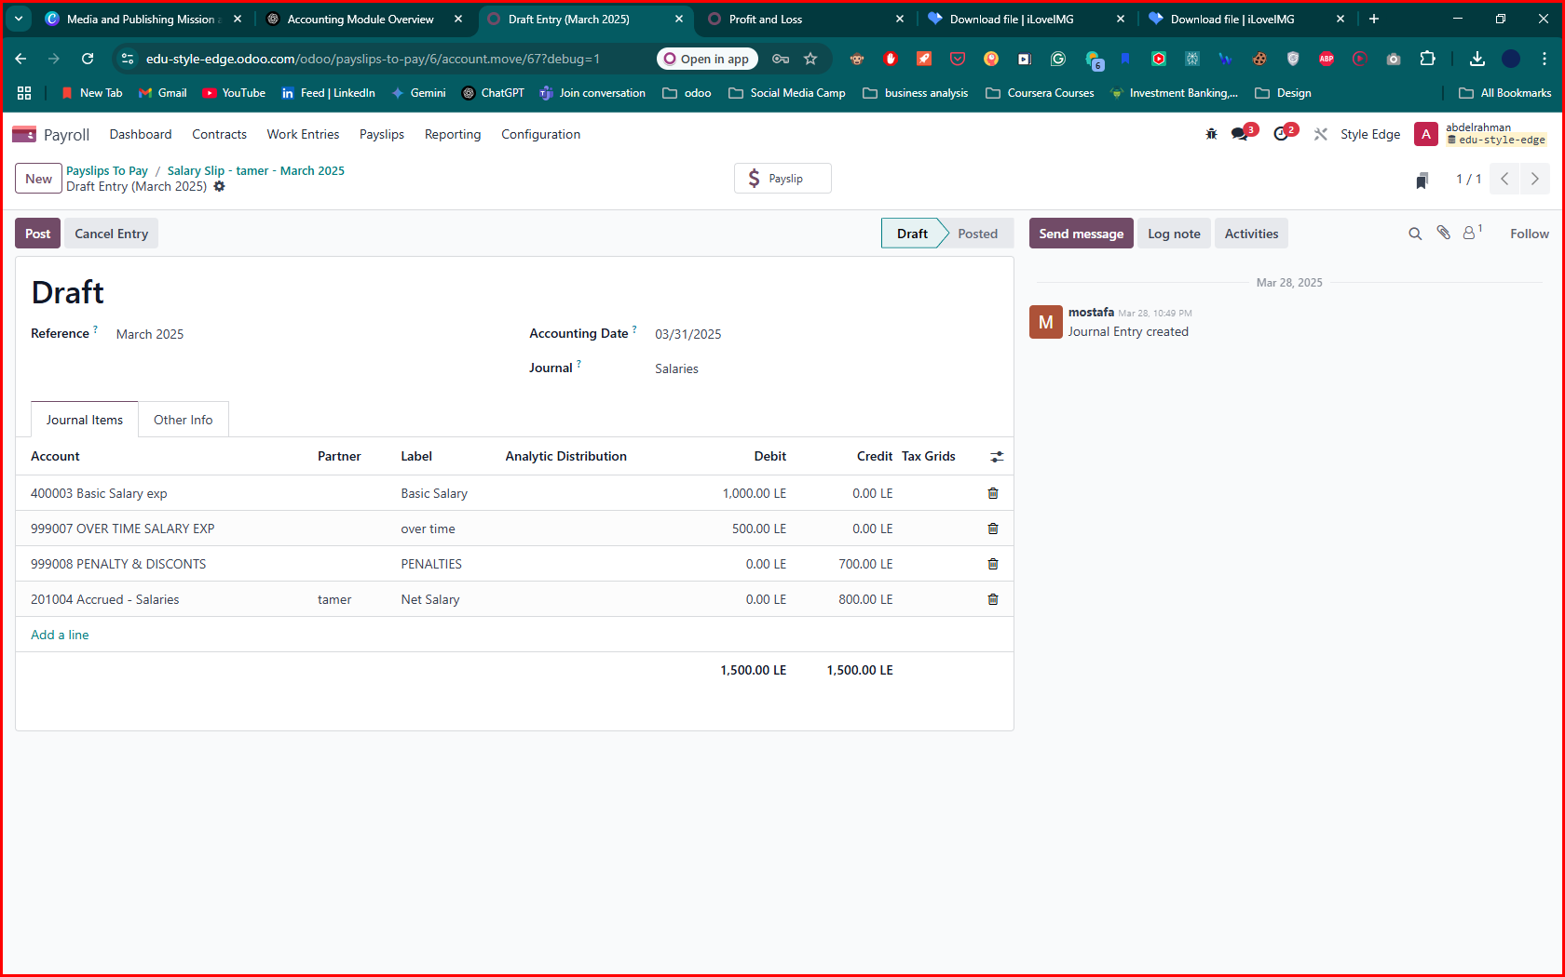
Payroll Entry
52

Slide 53
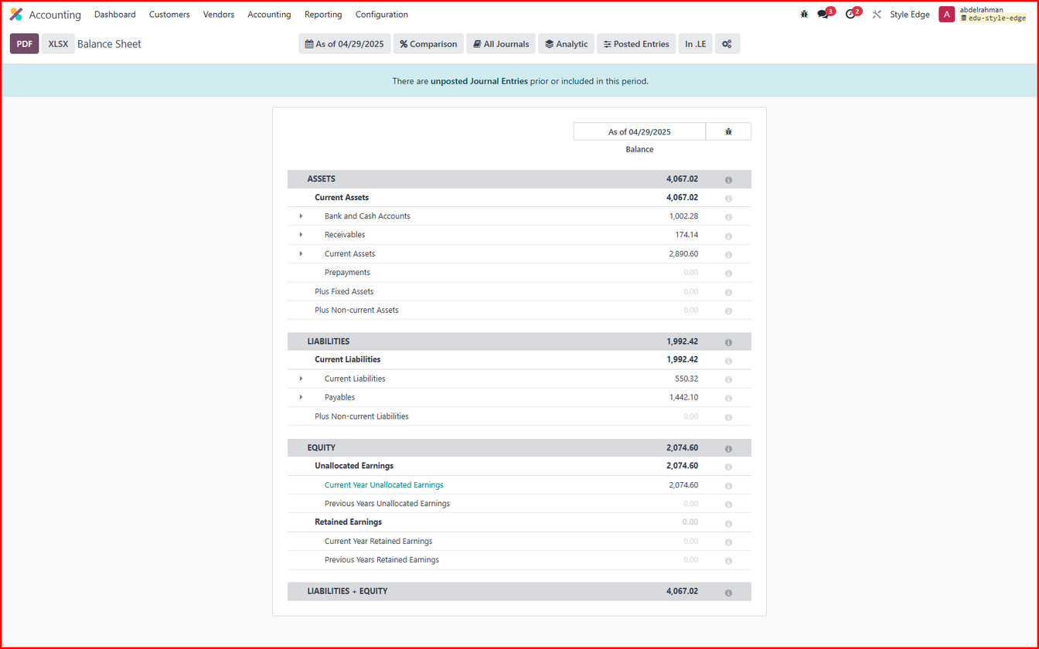
Reporting . Balance Sheet
53

Slide 54
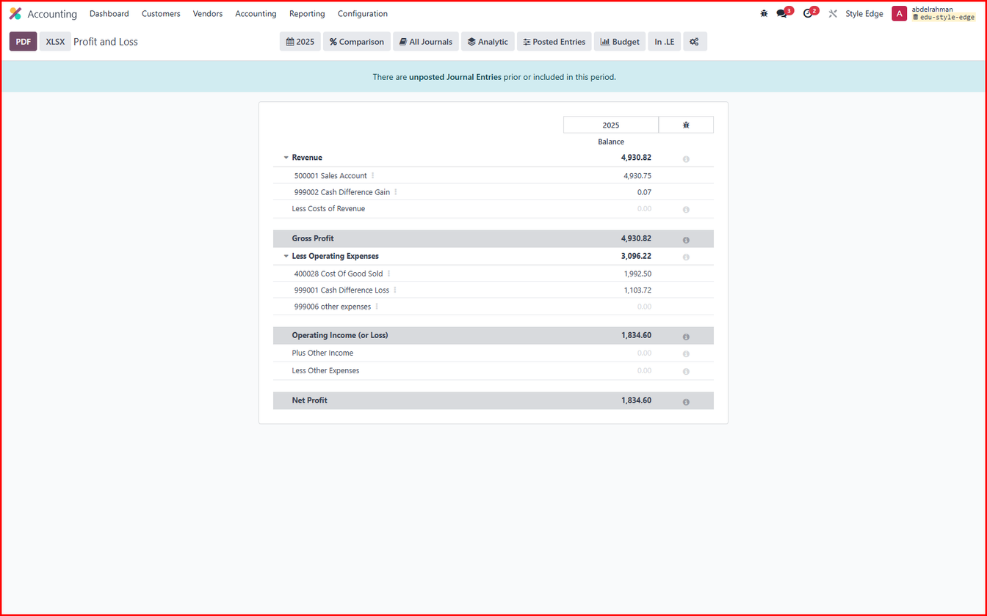
Reporting . Profit and loss
54

Slide 55
Thank you!
GROUP : NXT34 - ALX2 - ERP1 - G1
DIGITAL EGYPT PIONEERS INITIATIVE ROUND 2
NEXT ACADEMY
INSTRUCTOR : AHMED KHALIL

Slide 56




Abdulraman Ahmed
Odoo Implementer
Meet
The Team
Mostafa Amin
Odoo Implementer
Youssef Abdelaall
Odoo Implementer
Mohamed Abdelrazik
Odoo Implementer

